Slide 1
October 2023 release of Power BI apps on telemetry
Dynamics 365 Business Central

Slide 2
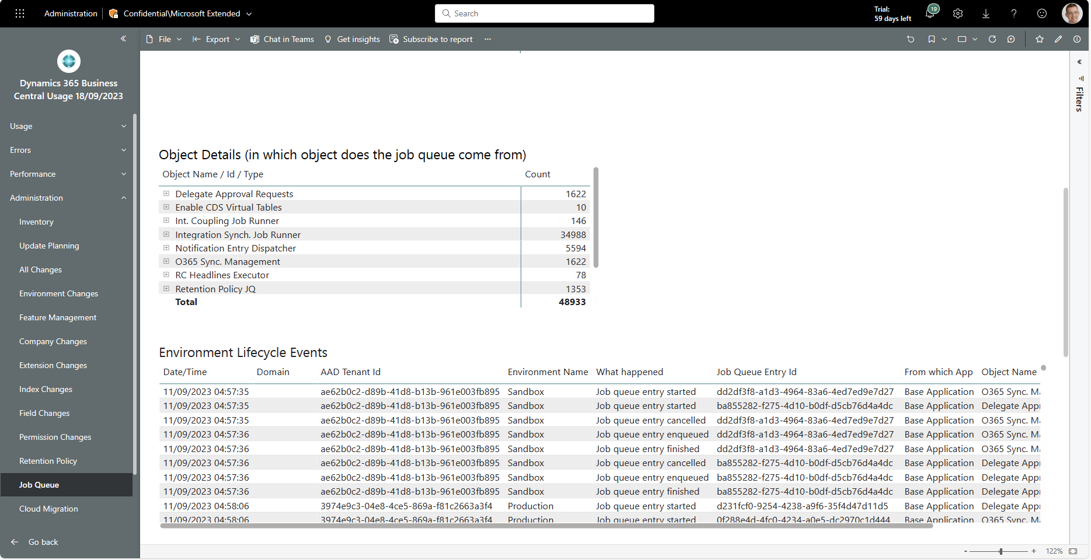
New administrator report: Job queue lifecycle
Find all job queue events (enqueued, started, stopped, failed, cancelled, retried, …) that happened across all customers.

Slide 3
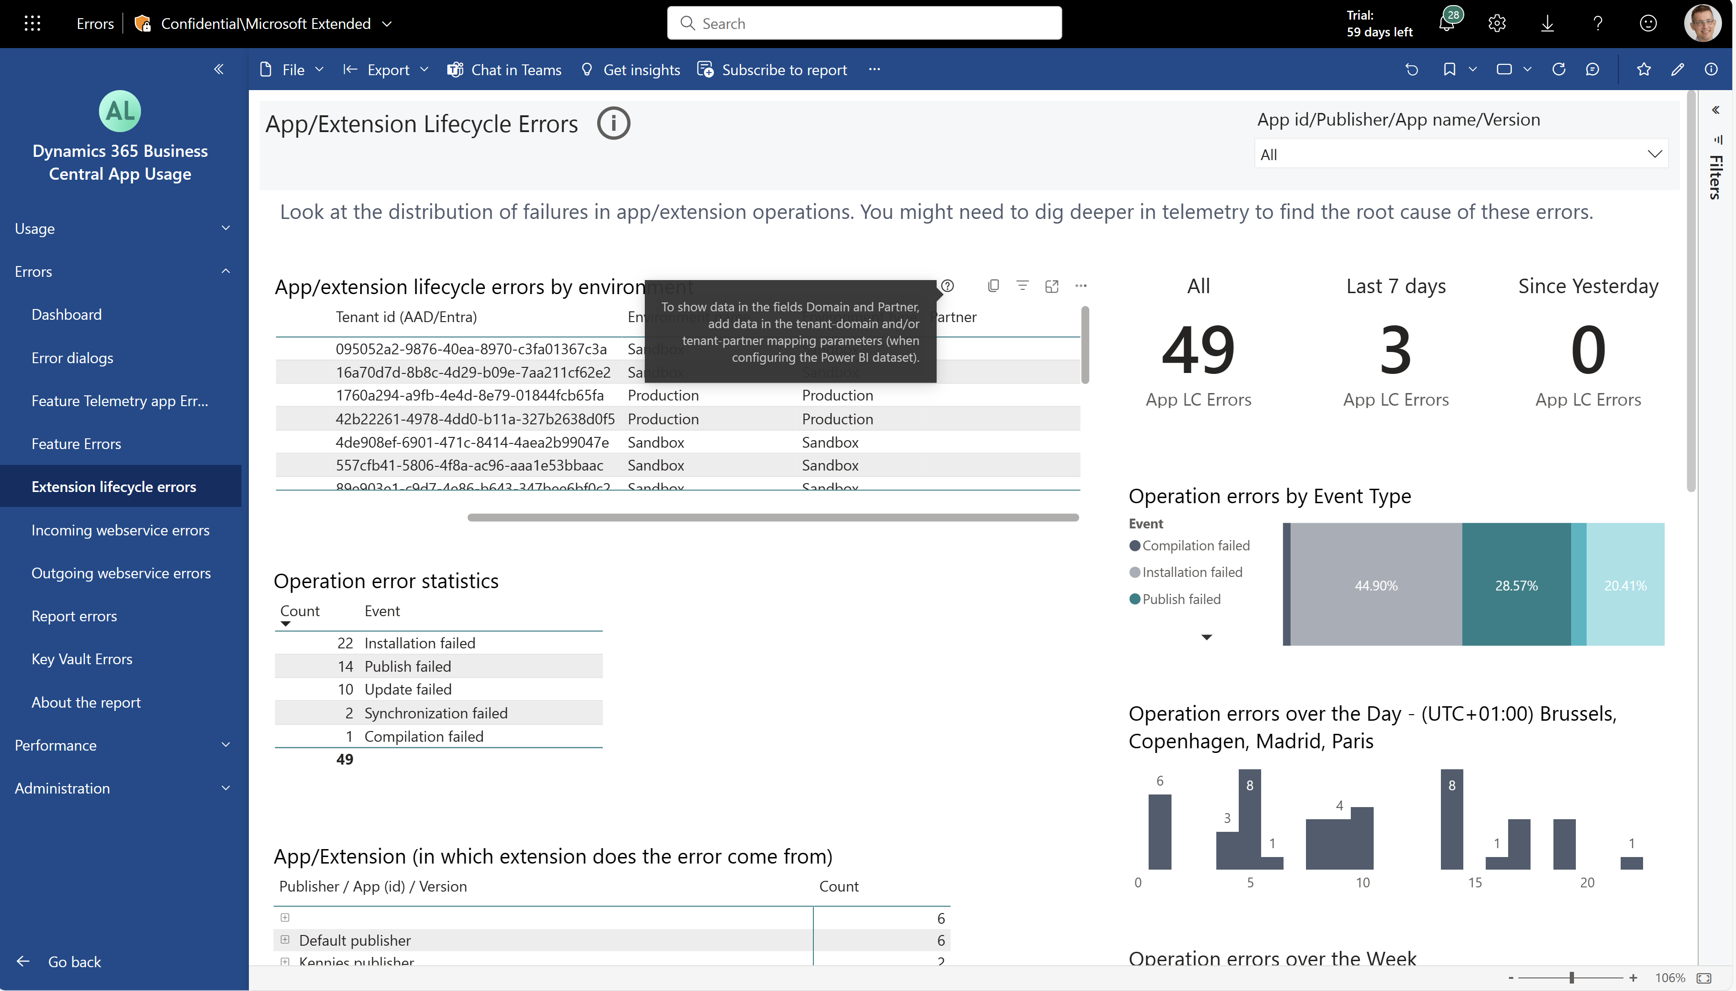
New mapping in the ISV app: tenant-partner
Allows you to track which partner to contact for a given customer.

Slide 4
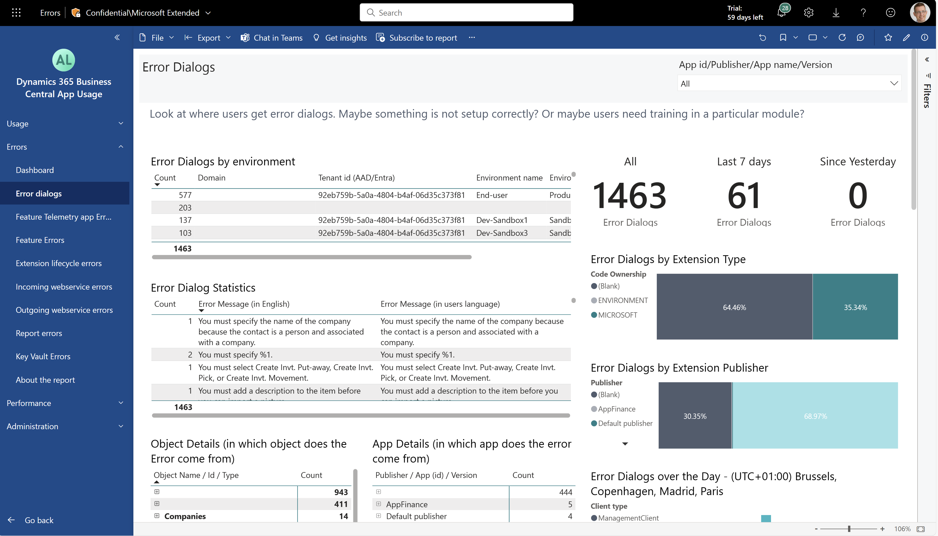
New visuals on error pages: X by environment
New X by environment visuals (on all error pages). Makes it easier to see impact of errors over your customer base.

Slide 5
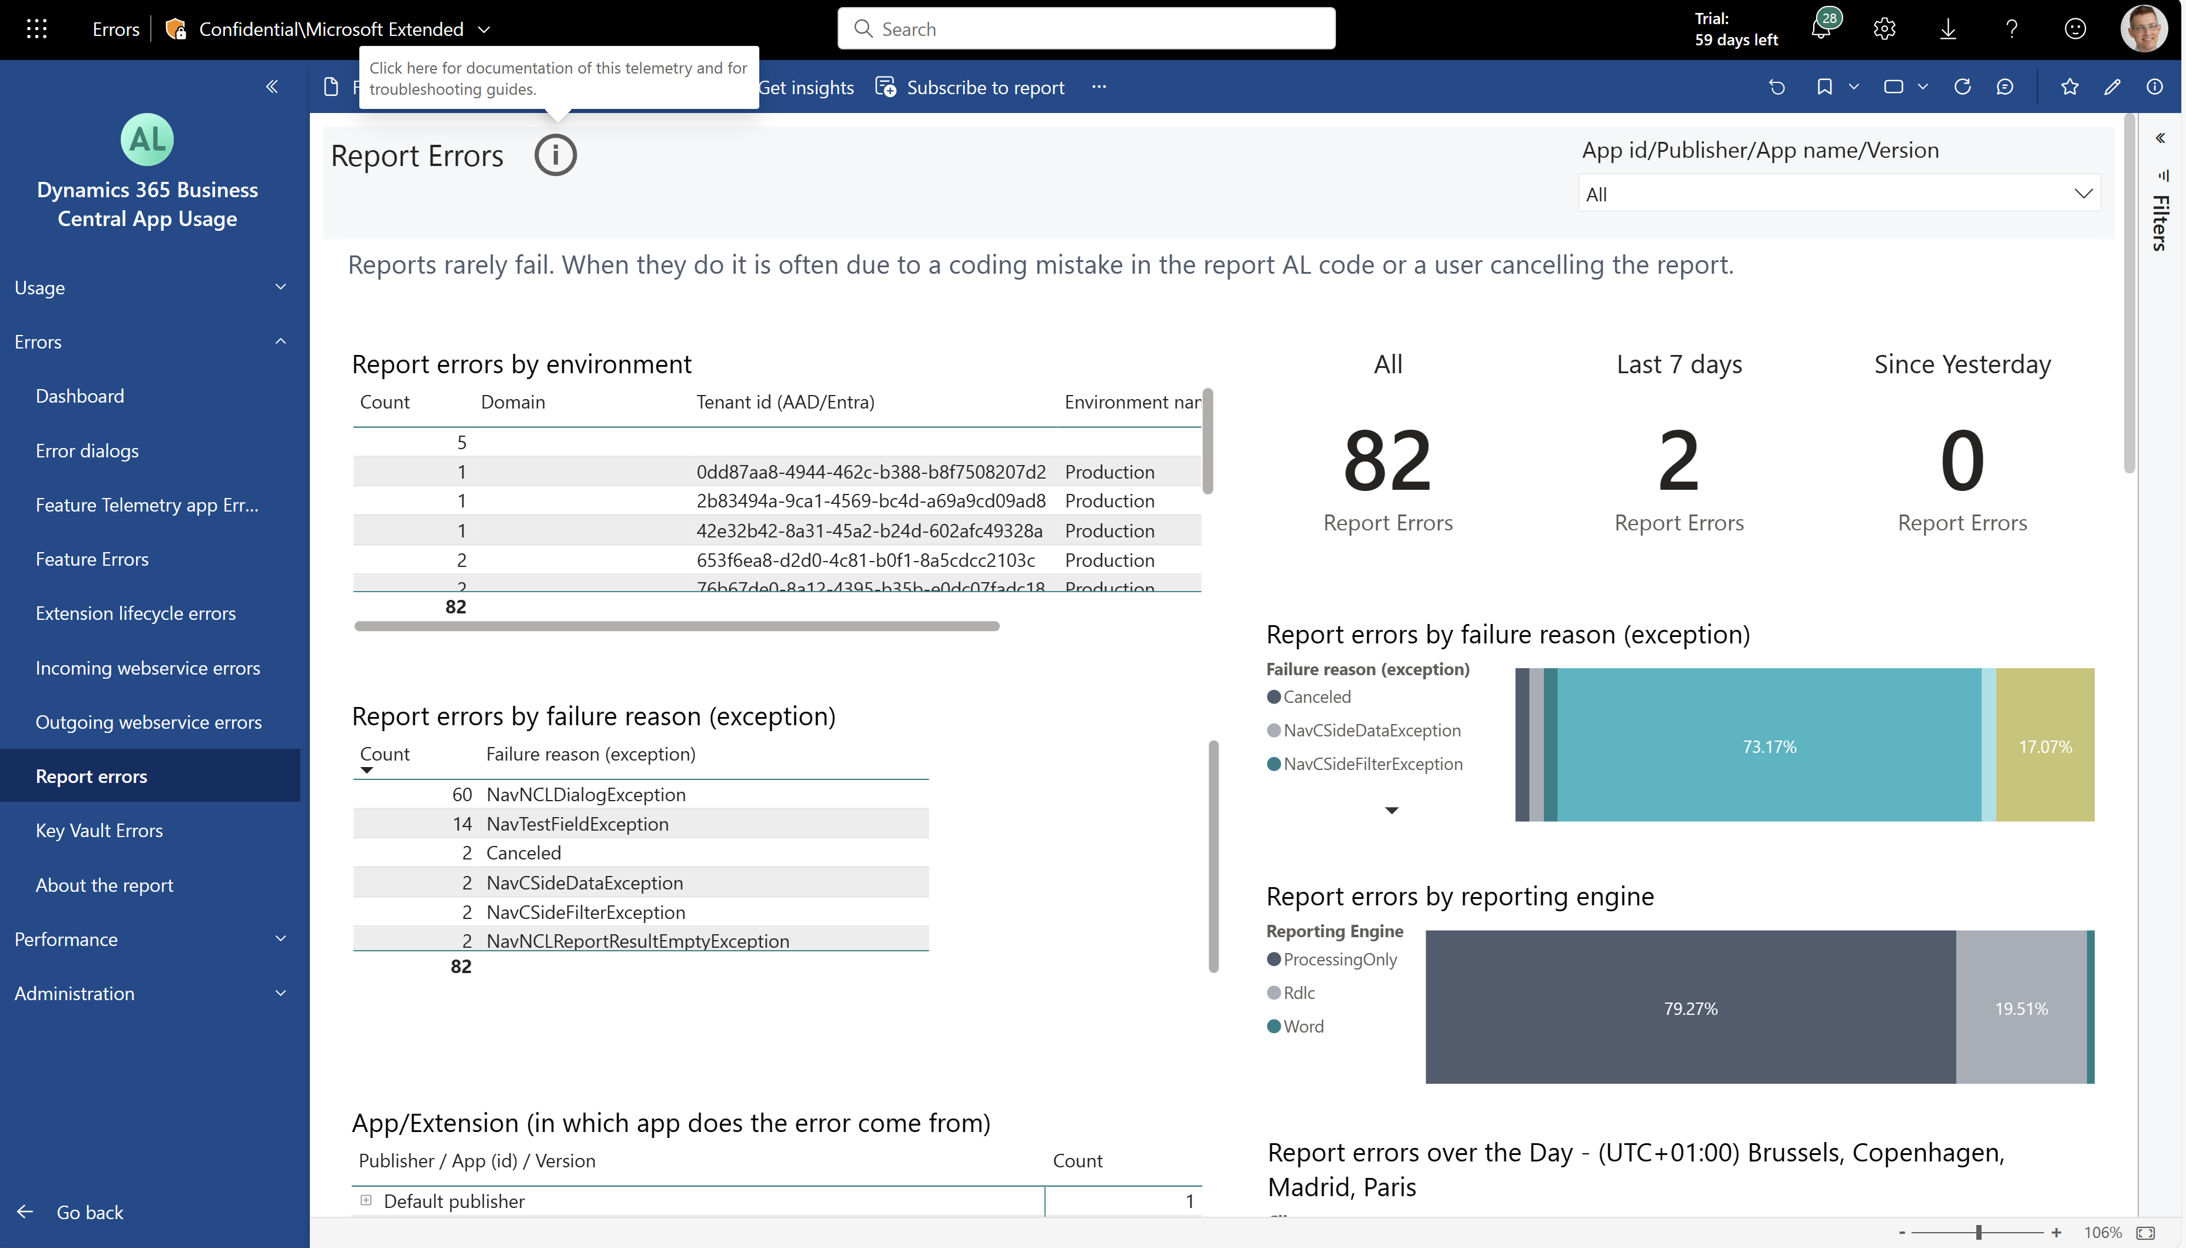
On error pages: added links to troubleshooting guide
Makes it easier to see what next steps to follow to drive down errors to zero.

Slide 6
On Report errors: fixed bug so that Exceptions now show up here
Makes it easier to troubleshoot report errors (TSG is coming soon on docs)

Slide 7
Get the apps from Appsource
For environment telemetry https://aka.ms/bctelemetryreport
For app telemetry https://aka.ms/bctelemetry-isv-app

